Slide 1
Lambda PCR

Slide 2
Reaction Parameters
~10³ copies Lambda DNA
0.5 or 0.2 uM primer-set
IDMO12-13 or IDMO14-15
60 or 65°C annealing temperature

Slide 3
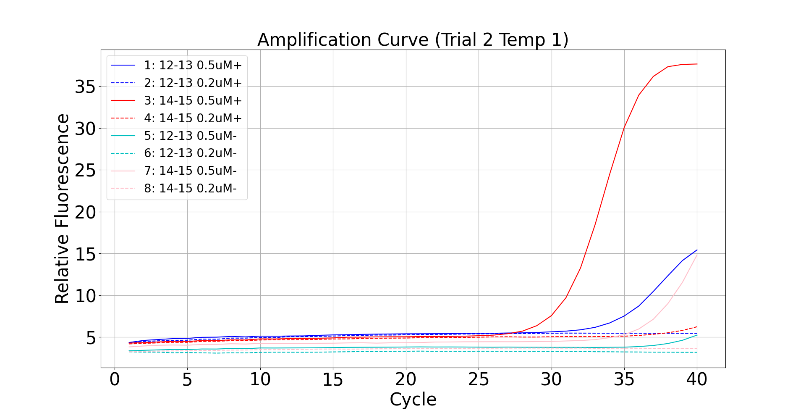
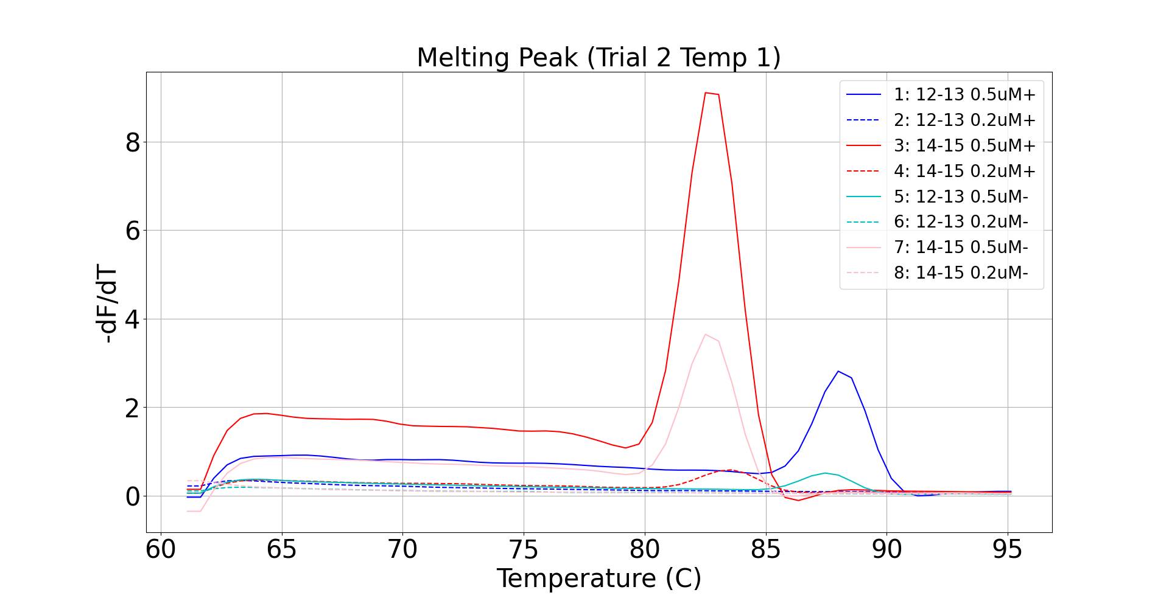
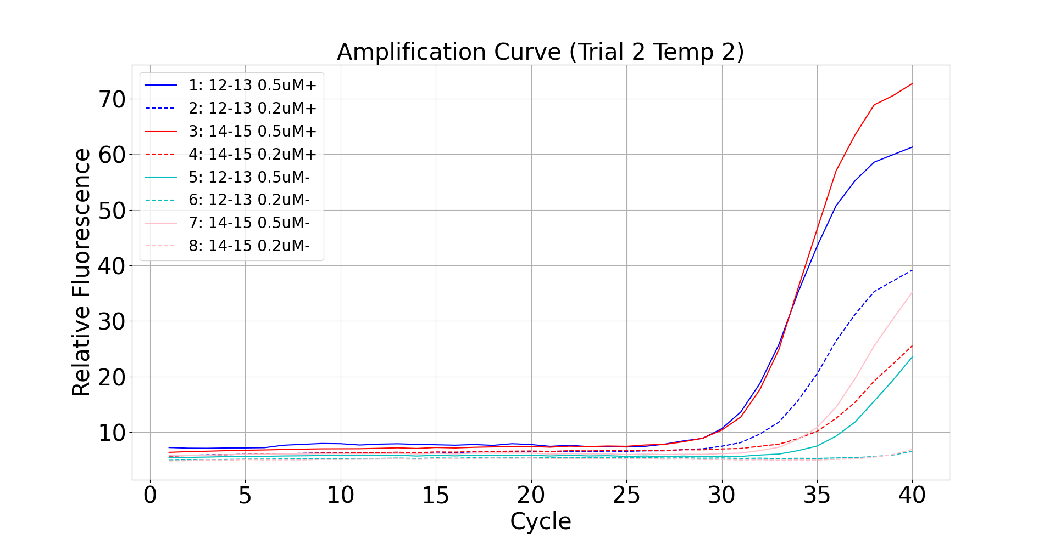
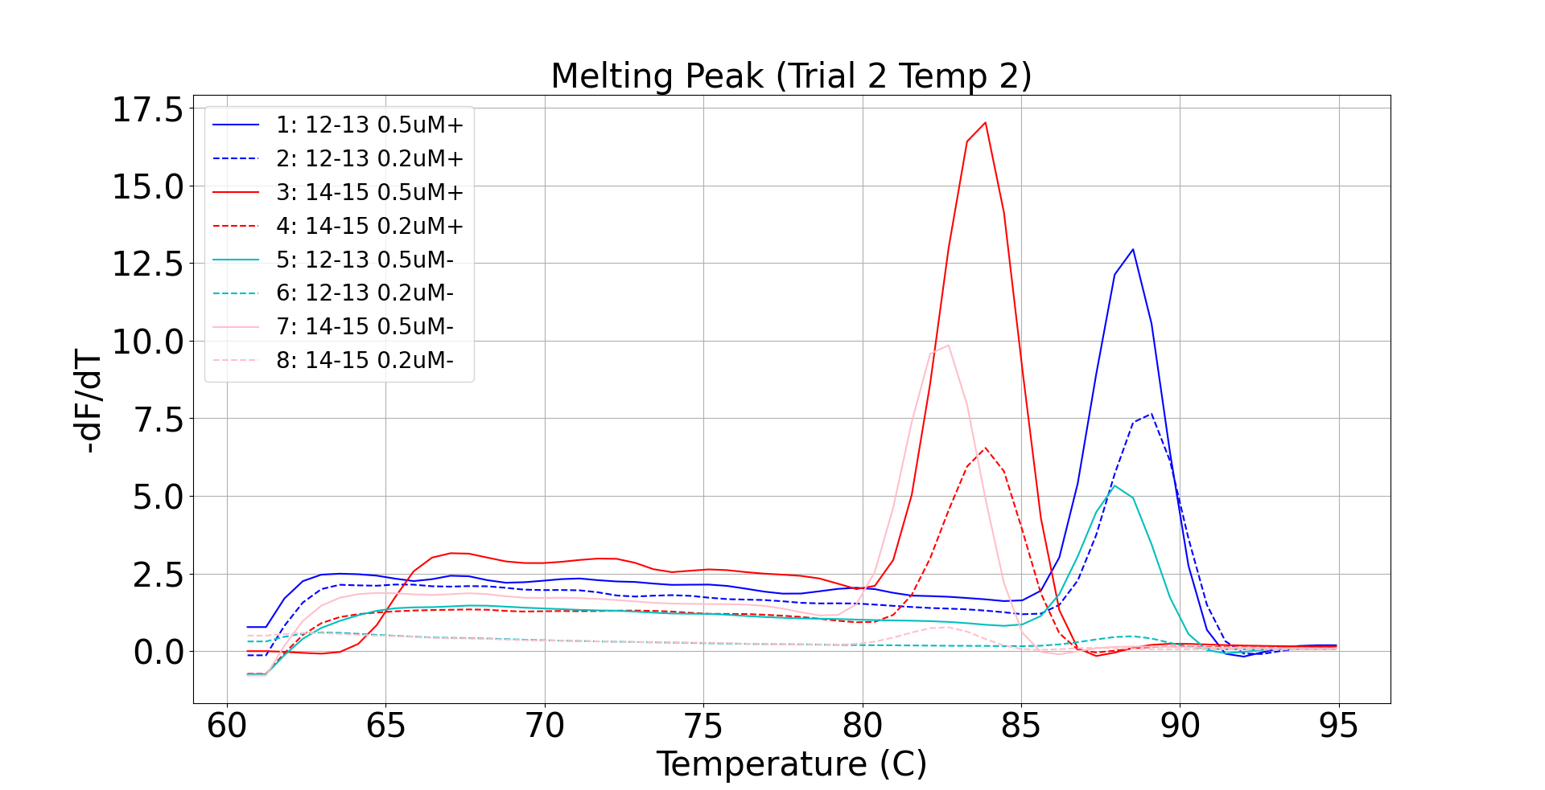
Sample Tm Value
12-13 0.5uM 87.71
14-15 0.5uM 82.58
Weaker signal
(60°C anneal)
Less primer-dimer
Sample Tm Value
12-13 0.5uM 88.14
12-13 0.2uM 88.60
14-15 0.5uM 82.33
14-15 0.2uM 83.48
Stronger signal
(65°C anneal)
More primer-dimer

